Slide 1
CNN – Step 2+3 (Max)Pooling & flatening
Slides are based on the course: Deep Learning A to Z by Kirill Eremenko AND Hadelin de Ponteves

Slide 2
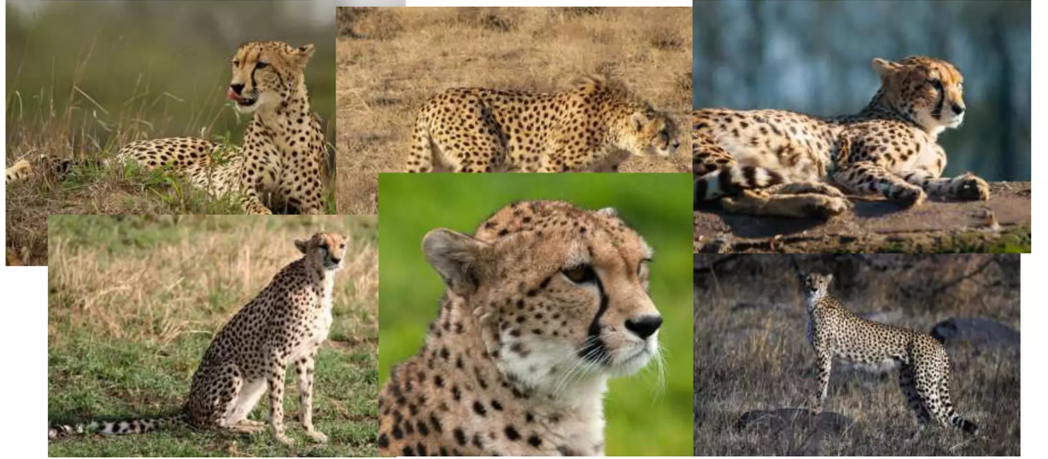
Max Pooling

Slide 3
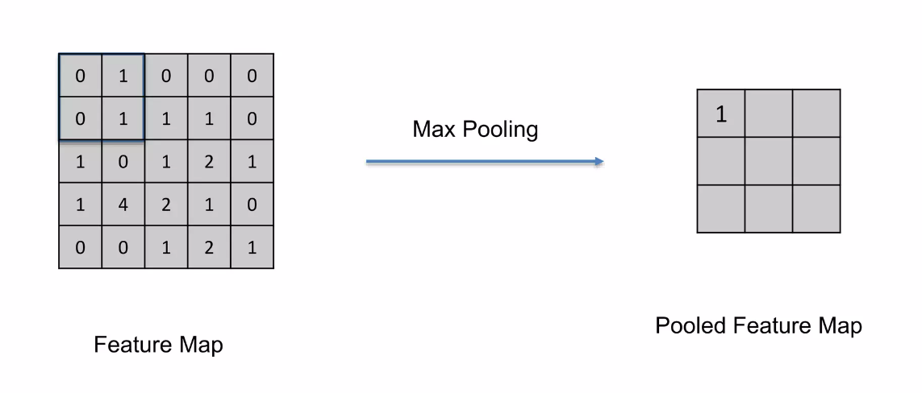
Max Pooling

Slide 4
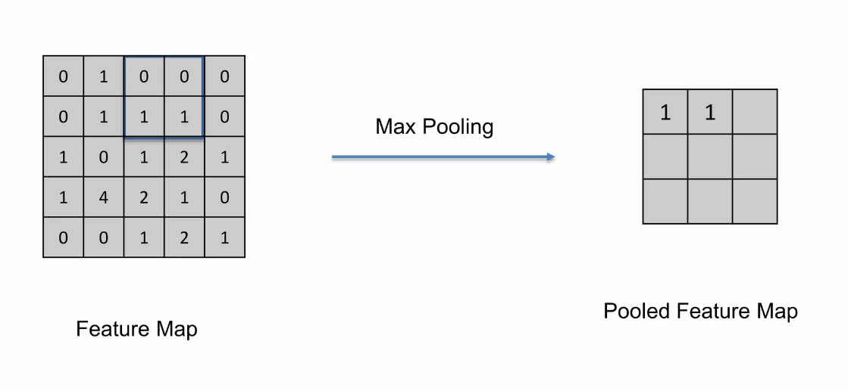
Max Pooling

Slide 5
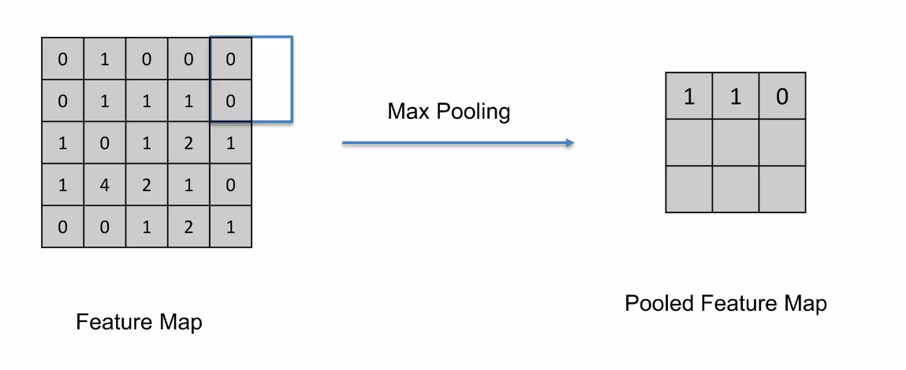
Max Pooling

Slide 6
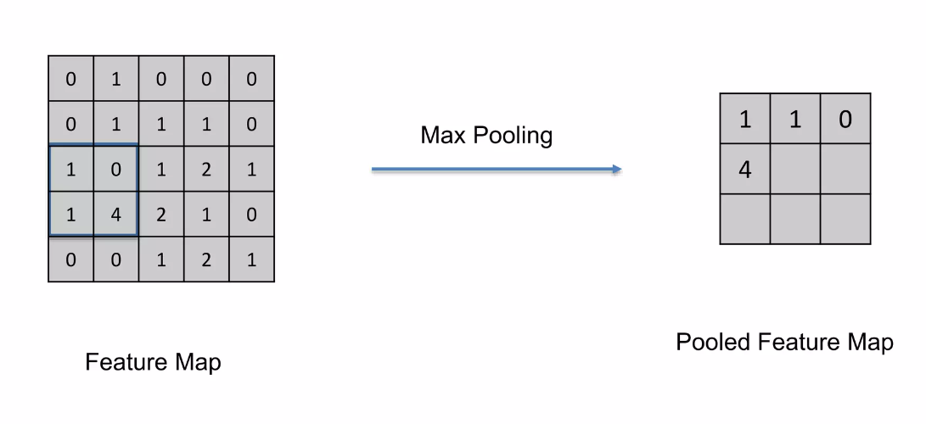
Max Pooling

Slide 7
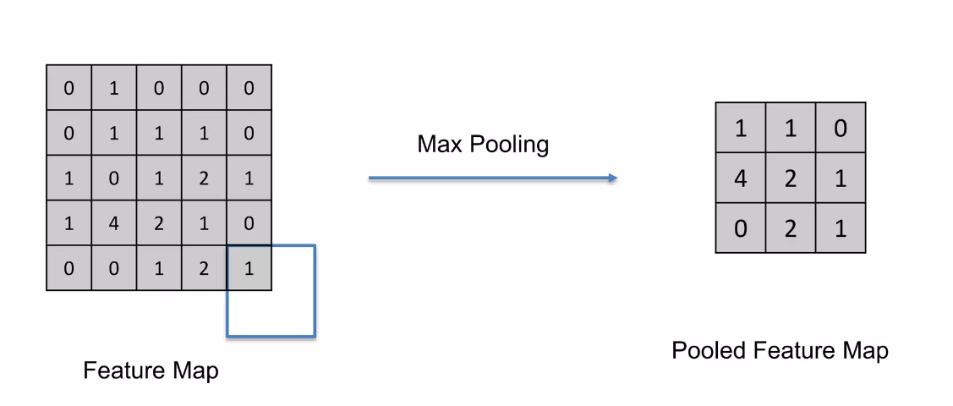
Max Pooling

Slide 8
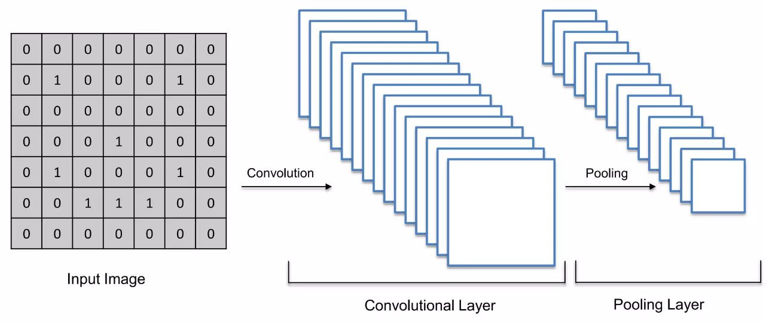
Pooling layer
Preserves the important features
Reduces the size of the image

Slide 9
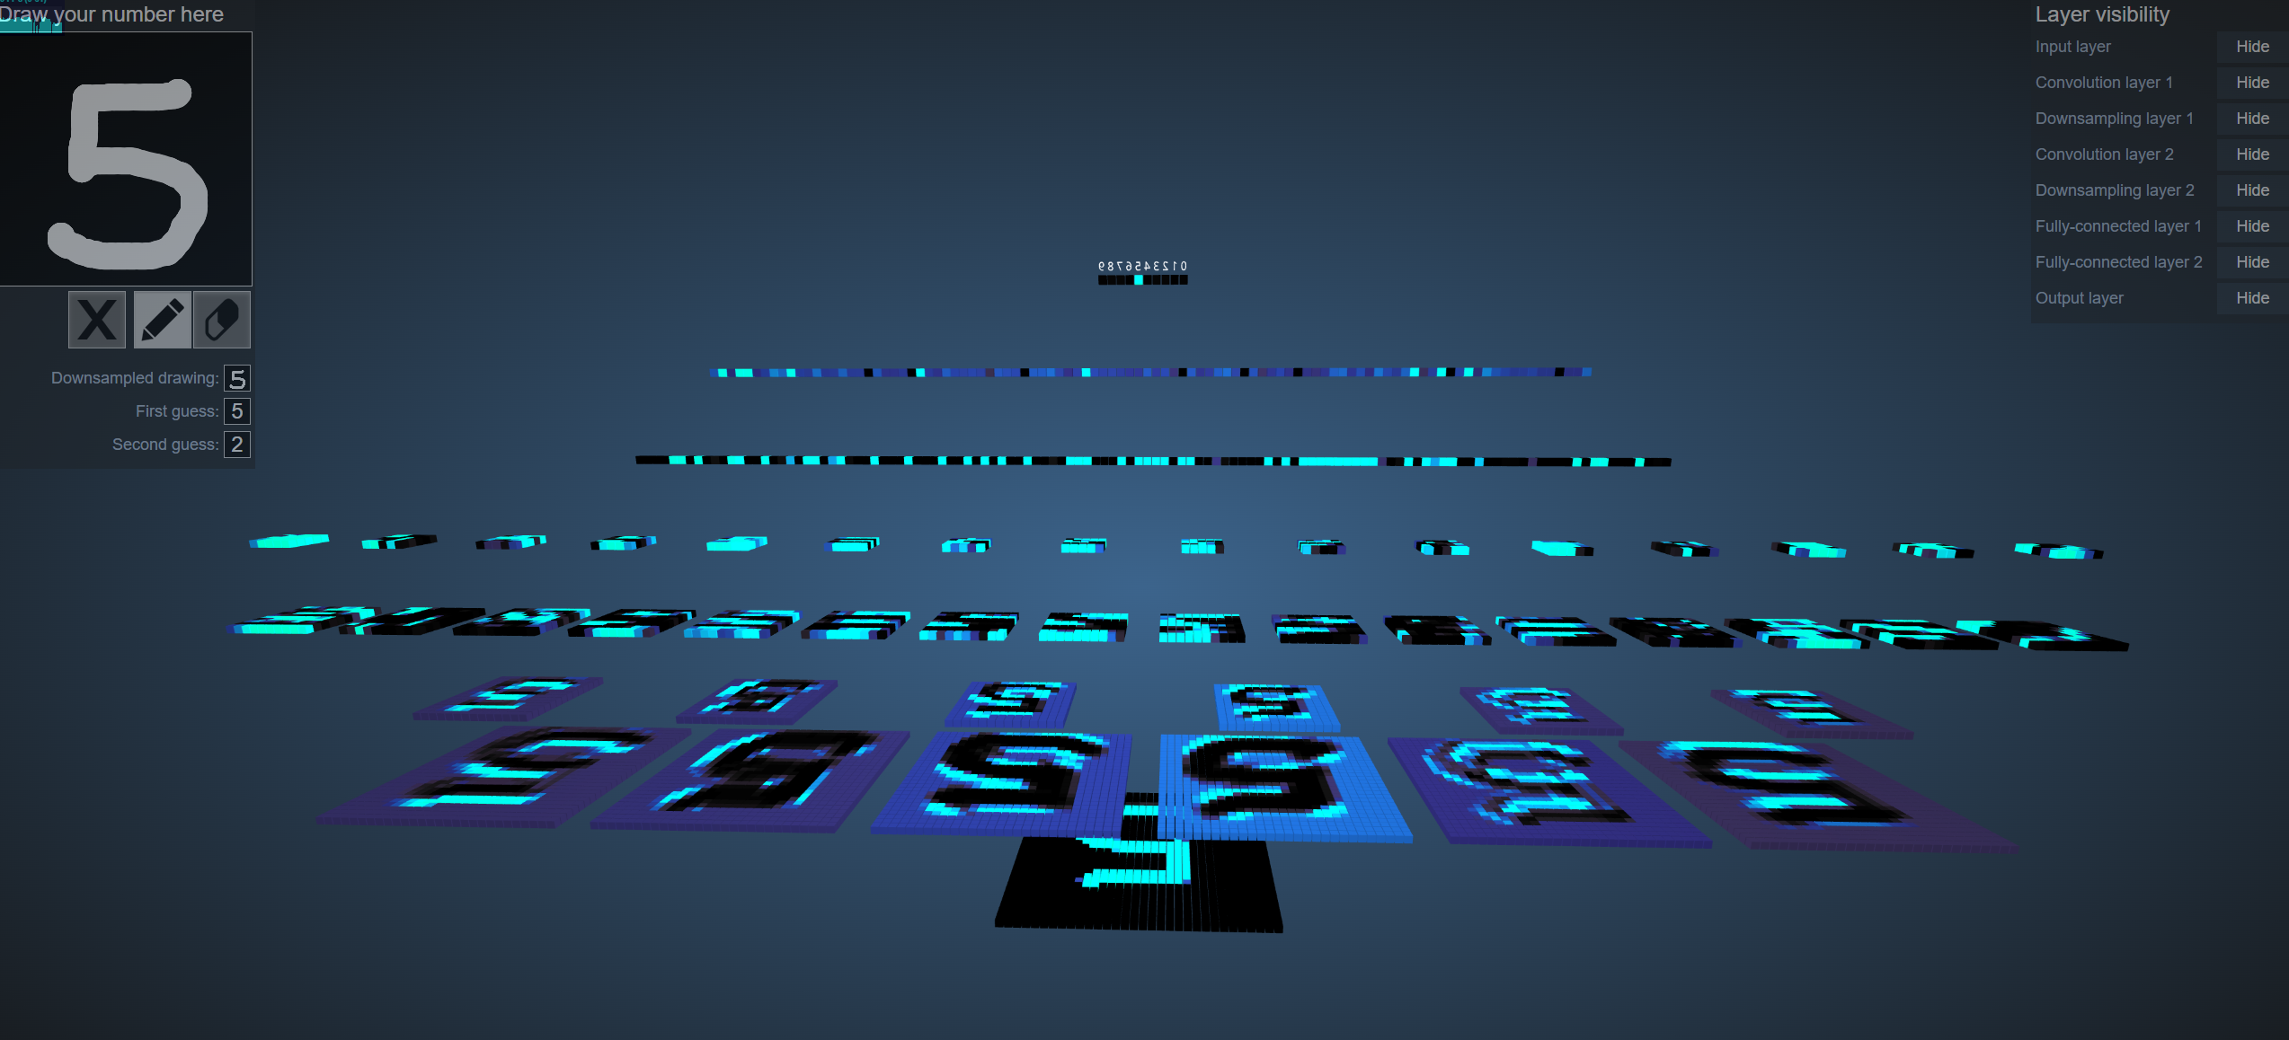
Visualization tool of the layers
https://adamharley.com/nn_vis/cnn/3d.html

Slide 10
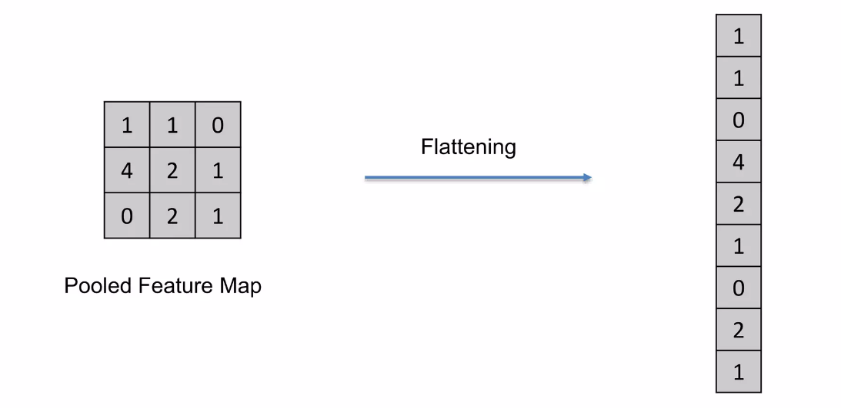
Step 3: Flatening

Slide 11
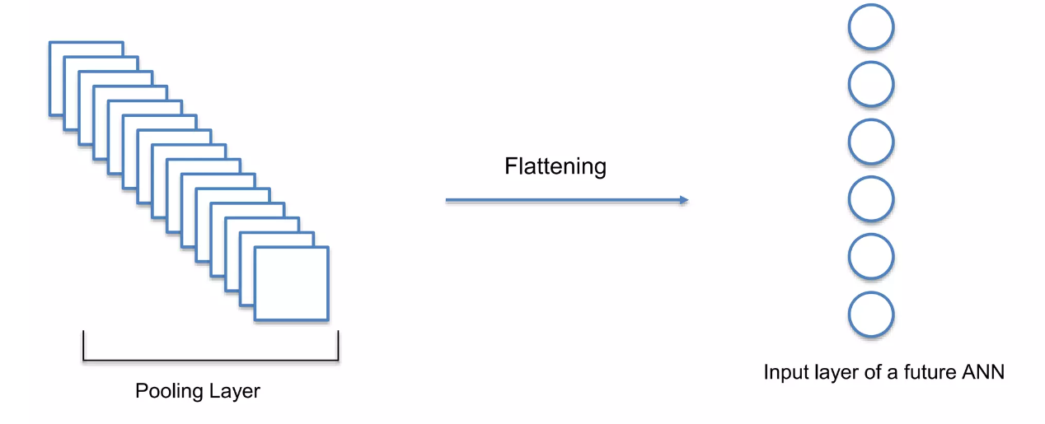
Step 3: Flatening

Slide 12
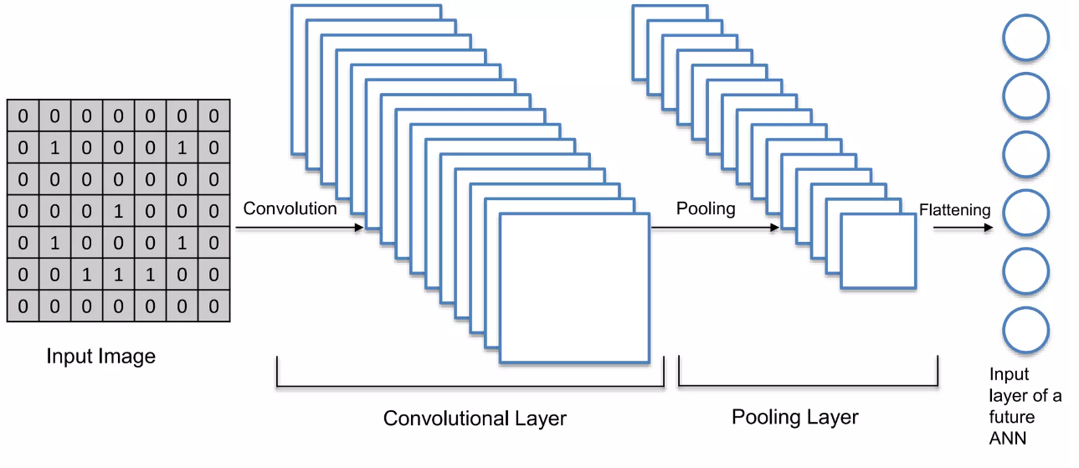
Summary

